Slide 1
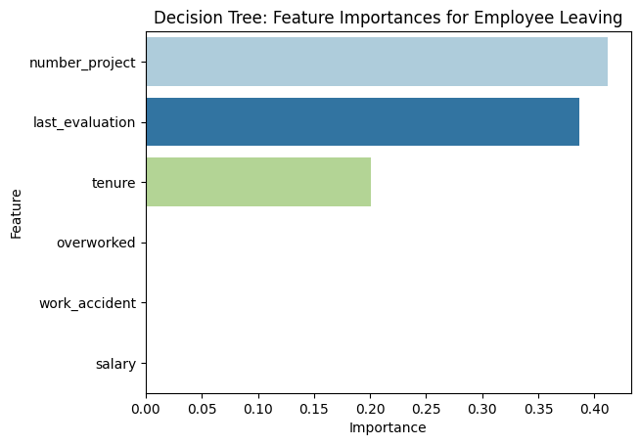
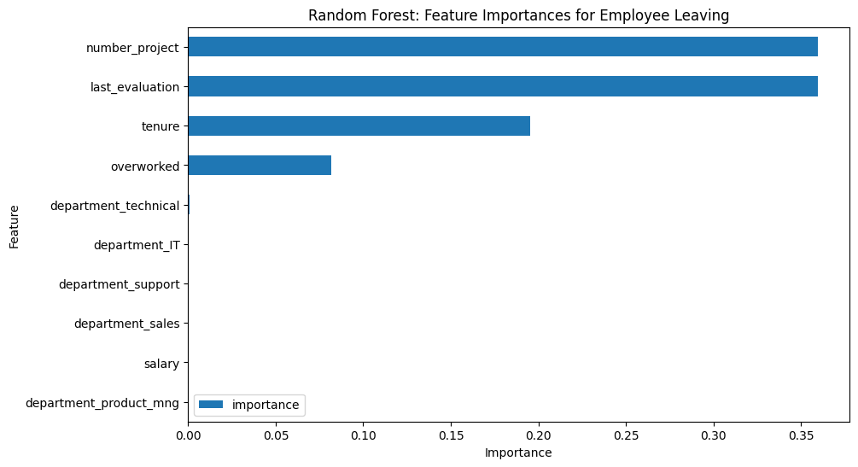
Salifort Motors
Enhancing Employee Retention with Advanced Machine Learning Models
Salifort Motors seeks to improve employee retention and answer the following question:
What’s likely to make the employee leave the company?
Since the variable we are seeking to predict is categorical, the team could build either a logistic regression or a tree-based machine learning model.
⇒ The random forest model modestly outperforms the decision tree model.
Barplot above shows the most relevant variables: ‘number_project’, ‘last_evaluation’, ‘tenure’.
This model helps predict whether an employee will leave and identify which factors are most influential. These insights can help HR make decisions to improve employee retention.
In the random forest model above : `number_project`, `last_evaluation`, `tenure` then `overworked` have the highest importance. These variables are most helpful in predicting the outcome variable, `left`.
Limiting the number of projects employees work on to 3-5
Limiting the number of hours employees work to a cap of 175 hours per month
Ensuring that employees are promoted every 3-5 years
Ensuring that employees receive good evaluation scores without having to work 200+ hours per month
Ensuring that employees are rewarded for working long hours
Promoting company-wide and within-team discussions to understand and address employee concerns

